Slide 1

CS 328 - Fall 2019
Assignment 5: Image classification using CNNs

Slide 2
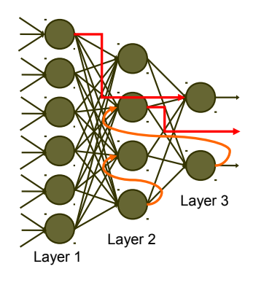
Fully Connected Layer:
Flatten 2D input and multiply by weights
Specify number of input and output neurons
Q: Can you get the number of weights?

Slide 3
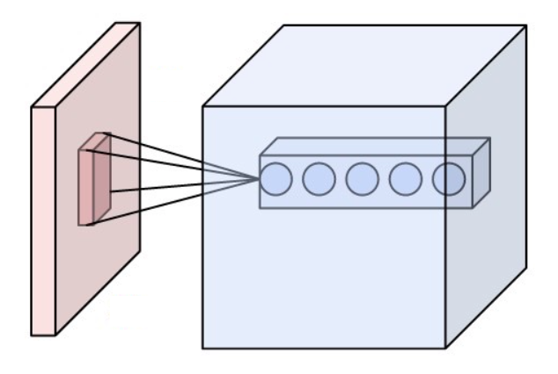
Convolution Layer:
A kernel sliding over 2D input, doing element-wise multiplication, adding to an output pixel
Input/output channels
Padding: padding edges with extra zeros to keep the size
Stride: specifies how many pixels to skip at each slide
Output shape: (In - F + 2P)/S + 1
P = (F-1)/2
http://cs231n.github.io/convolutional-networks/
Q: why do we prefer CNN over Fully-Connected layers?
Notes:
Paramater sharing

Slide 4
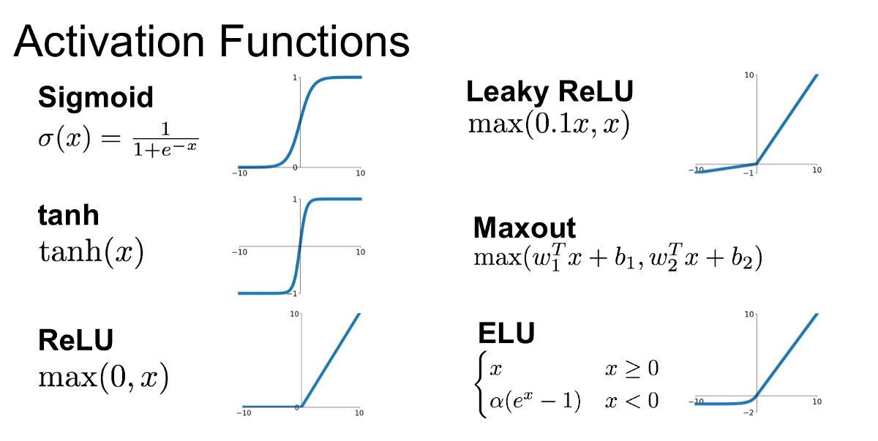
Notes:
To introduce non-linearty

Slide 5
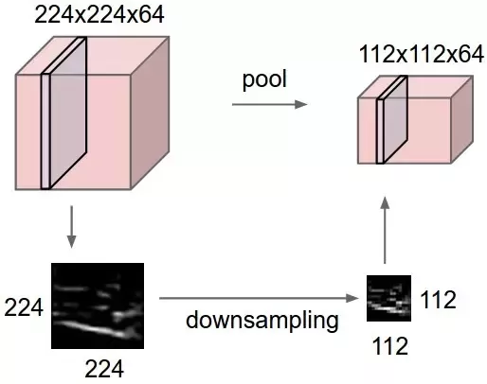
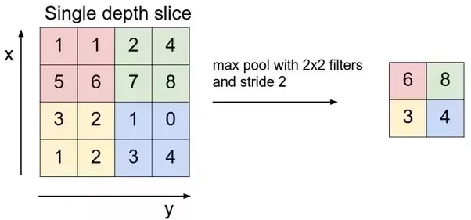
MaxPooling:
https://www.quora.com/What-is-max-pooling-in-convolutional-neural-networks

Slide 6
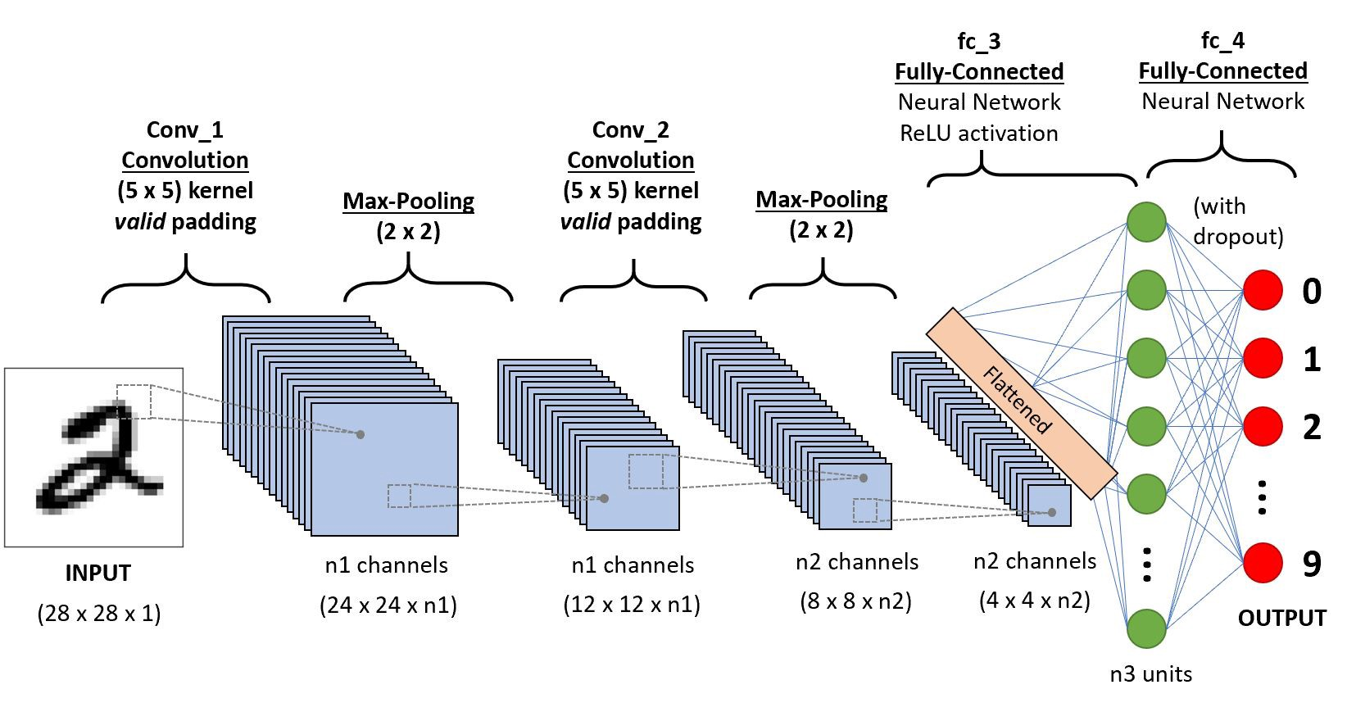
How a classification network looks like:

Slide 7
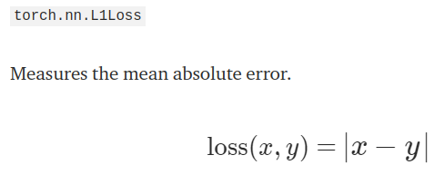
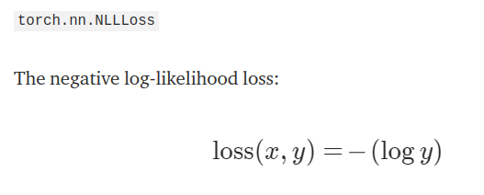
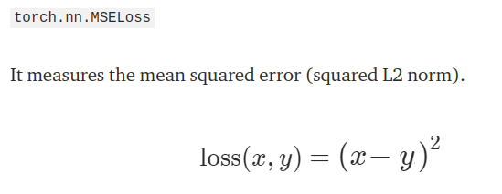
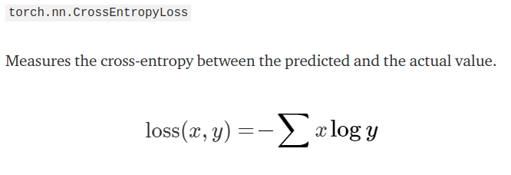
Loss functions:

Slide 8
Dataset

Slide 9
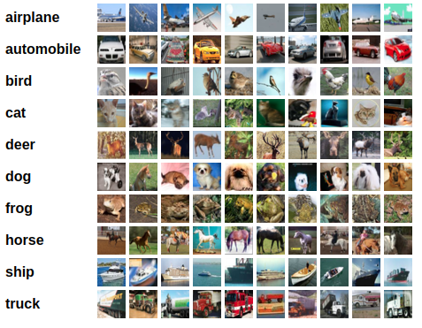
CIFAR-10 Dataset
32x32 RGB images of different objects
60000 in 10 classes, with 6000 images per class, divided as 50000 training images and 10000 test images.

Slide 10
Different Data splits:
Train Data (45,000)
Validation Data (5,000): Last 10% of the training data
Test Data: Shouldn’t be included in the training process, even for fine-tuning the hyperparameters

Slide 11
Implementation Steps:
Define your train, validation, and test data loaders in load_dataset function
Define your model
Define loss and optimizer
Try different loss functions + different optimization techniques [optional]
Add weight regularization to the loss
Initialize model weights using Xavier initialization
Implement the training loop + validation
Test the model on the test-set

Slide 12
Useful PyTorch functions:
Optimizer: Adam, SGD, etc:
torch.nn.CrossEntropyLoss
Data Loader : torchvision.datasets.CIFAR10
Data Samplers
Conv, fully connected layer, activation functions
Reference: https://pytorch.org/tutorials/beginner/blitz/neural_networks_tutorial.html

